Slide 1
SDLC & MODELS

Slide 2
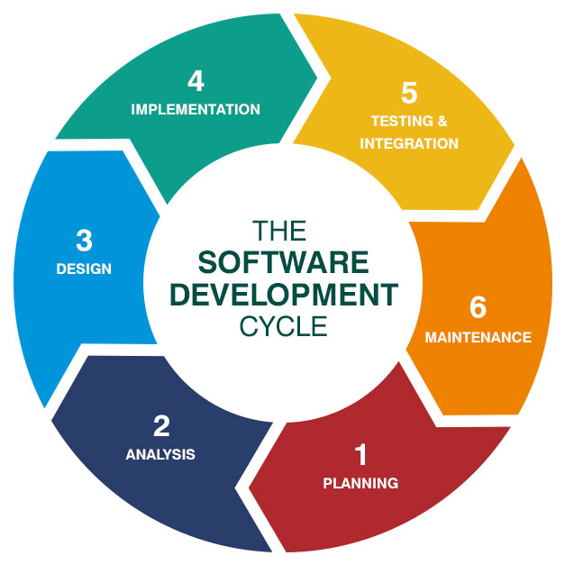
What is SDLC?
The software development life cycle (SDLC) is a structured process used for developing software applications. It provides a systematic approach to software creation, ensuring that development is efficient, organized, and results in high-quality software.
SDLC typically consists of several phases, including:
Planning
Requirements Gathering
Design
Development
Testing
Deployment
Maintenance

Slide 3
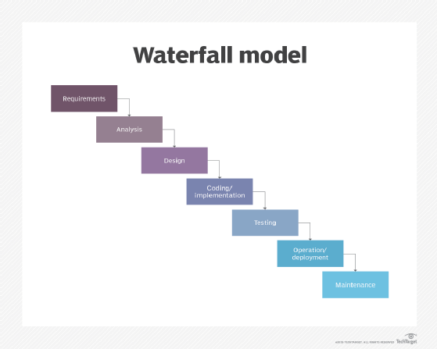
Waterfall model
The Waterfall model is a linear and sequential approach to software development. Each phase of the project must be completed before the next one begins.
ADVANTAGES:
Ideal for smaller projects
Simple and easy to understand
DISADVANTAGES:
Lack of flexibility
Customer feedback comes late

Slide 4
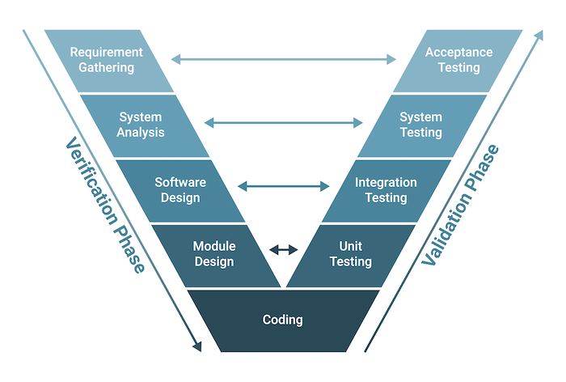
V MODEL
The V-Model (Validation and Verification Model) is an extension of the Waterfall model that emphasizes testing at each stage of development.
Advantages:
Early defect detection
Well-organized testing
Drawbacks:
Inflexible
High cost for changes

Slide 5
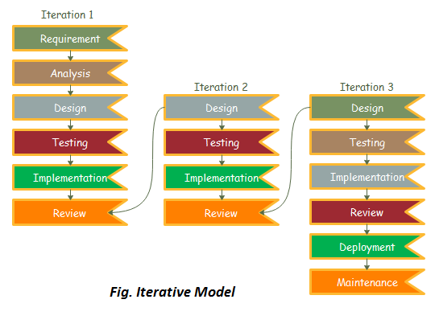
Iterative model
In each iteration, a portion of the software is developed, tested, and reviewed, allowing the project to evolve over time.
Advantages:
Early problem detection
Progressive delivery
Drawbacks:
Complexity in integration

Slide 6
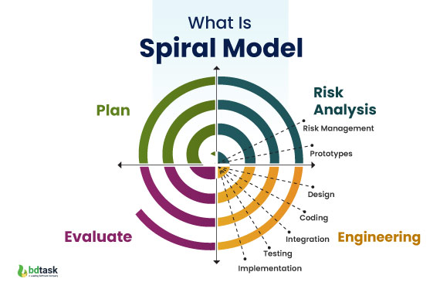
Spiral model
The Spiral Model is a risk-driven software development process model that combines elements of both iterative and waterfall models.
Advantages:
Risk management
Flexibility
Customer feedback
Drawbacks:
Complexity
Costly Time-consuming:

Slide 7
Challenges in SDLC
Compared to Agile, SDLC (often referring to the traditional Waterfall model) has limitations that make it less suited for dynamic and iterative projects. Agile is generally considered a better approach in modern software development, particularly for projects that require flexibility and adaptability.
Here’s why Agile is often seen as superior:
Flexibility
Customer Collaboration
Faster Delivery
Risk Management
However, SDLC can still be beneficial for projects that have well-defined requirements and minimal need for change throughout development

